Slide 1

Future location prediction System
Project-1
Presented by : Prakash Kumar

Slide 2
What is future location prediction system?
These features and functionalities can be implemented through various machine learning algorithms which are compared to determine the most accurate one. The proposed system can predict a user's future location using the current location and time, learning from the user's previously visited locations.

Slide 3
Task Description:
We need you to develop a future location prediction system using dataiku data science studio. In this task we will learn how tools like DSS are used in industry to develop industrial machine learning applications.

Slide 4
Dataset
The dataset is provided by Hackveda and this dataset has some features and one target value.
Download the dataset using this link:
https://trello.com/1/cards/623875f4afab8d12d53137fb/attachments/629da3d83c56ec0d92fb280d/download/LocationDataset.csv

Slide 5
Features(Input values)
1. Event time start
2. Event time end
3. Longitude start
4. Latitude start

Slide 6

Lables (Target)
1.Longitude end
2. Latitude end

Slide 7
Steps to apply ML models on our dataset:
Import
Import all the necessary modules.
Load
Load the given dataset.
Split
Split the data in the ratio of 80:20 for training and testing.
Train
Train the data with the particular model.
Get
Get the accuracy score of each model.
Plot
Plot the graph between predicted and test value.
Select
Select the best model with high accuracy.

Slide 8
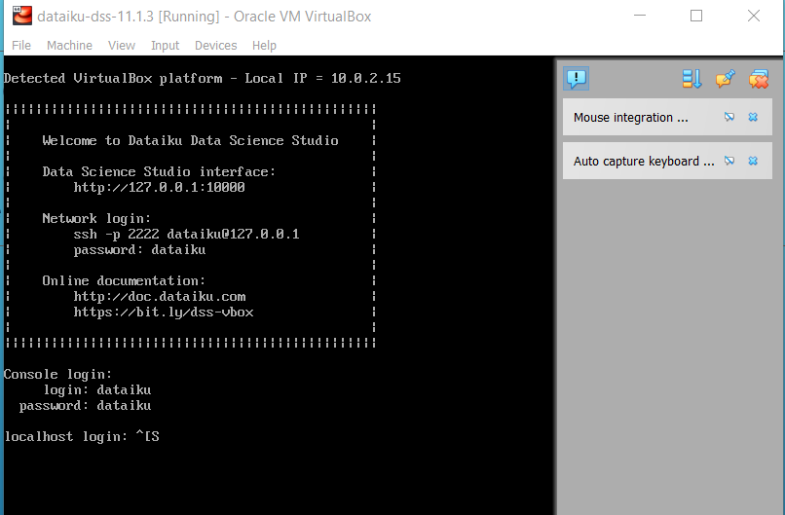
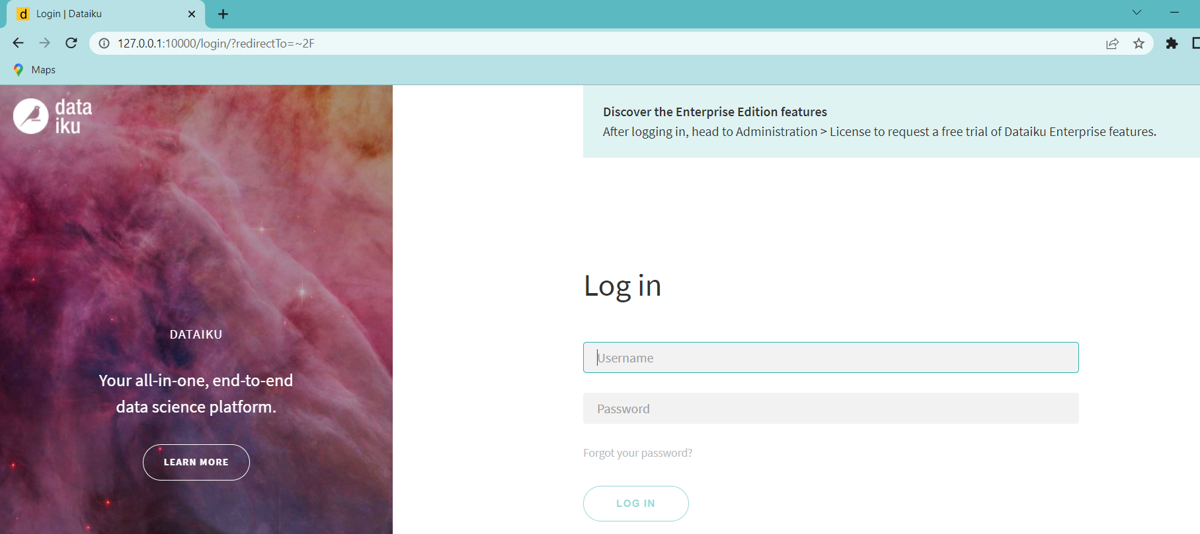
Installing dataiku in Windows
Import the dataiku image file in the virtual box and start the dss server.
And In the local browser go to 127.0.0.1:10000 to get the interface of the dataiku

Slide 9
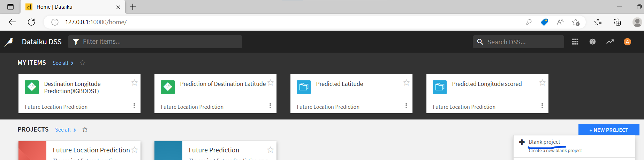
To start the new project click on new project and select the blank project and name it.

Slide 10
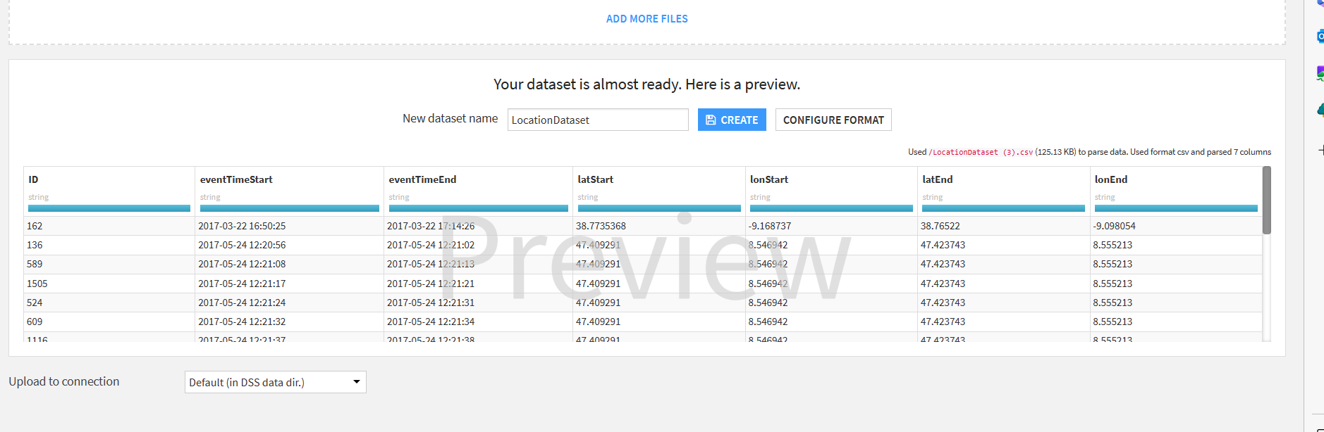
Import the first dataset and name that dataset. And click on create

Slide 11
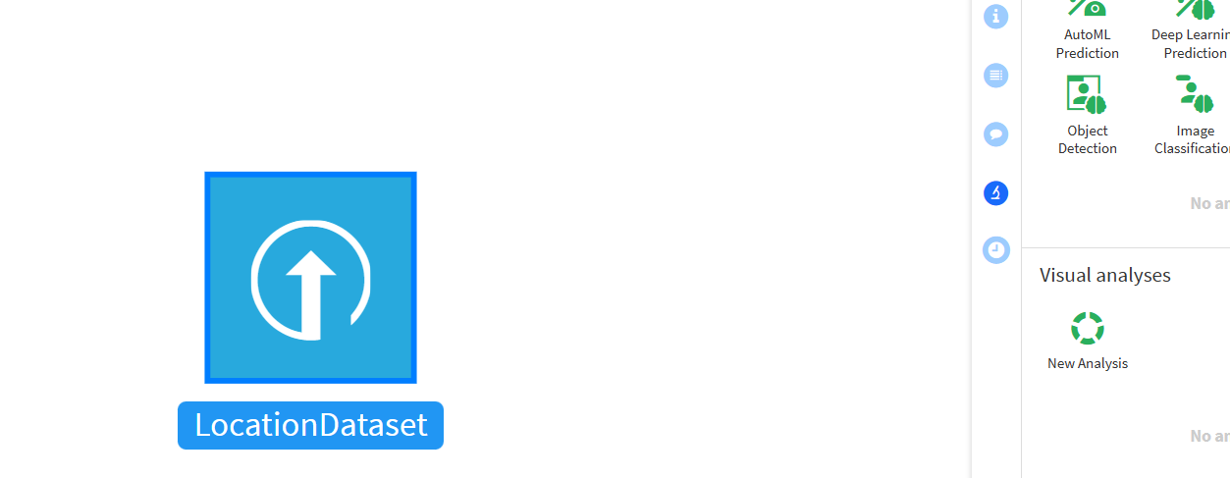
Select the dataset and click on lab → New analysis. As we have to analyze this dataset. And also name that analysis with a suitable name.

Slide 12
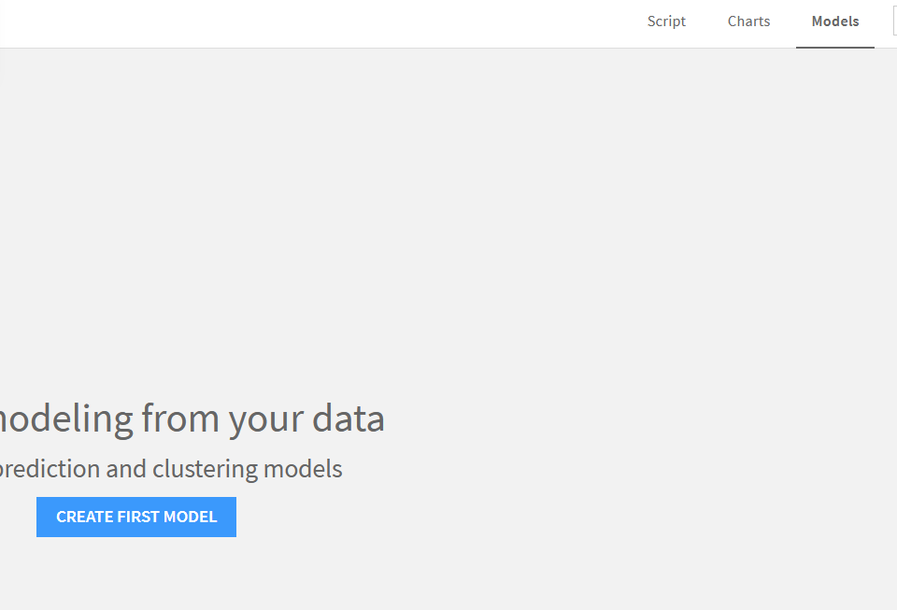
Now we have to create our first model so in the right corner go to Models→ Create our first model

Slide 13
As we have to predict the location the location of a object consist of to points on globe Latitude, Longitude. So in the dataset there is latEnd(Latitude End), lonEnd(Longitude End)on which we have to build our models.

Slide 14
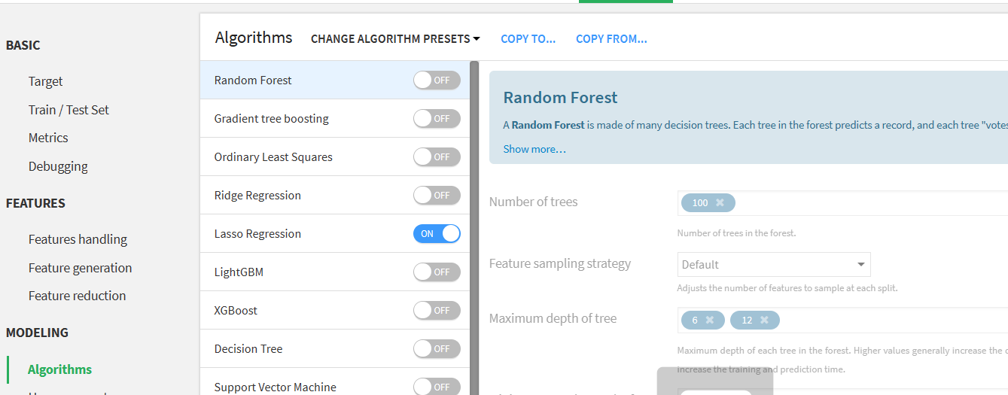
So First we will build the model on LatEnd column. We use Lasso Regression algorithm for this model because it gives the highest R2 Score(accuracy) and less mean error.

Slide 15
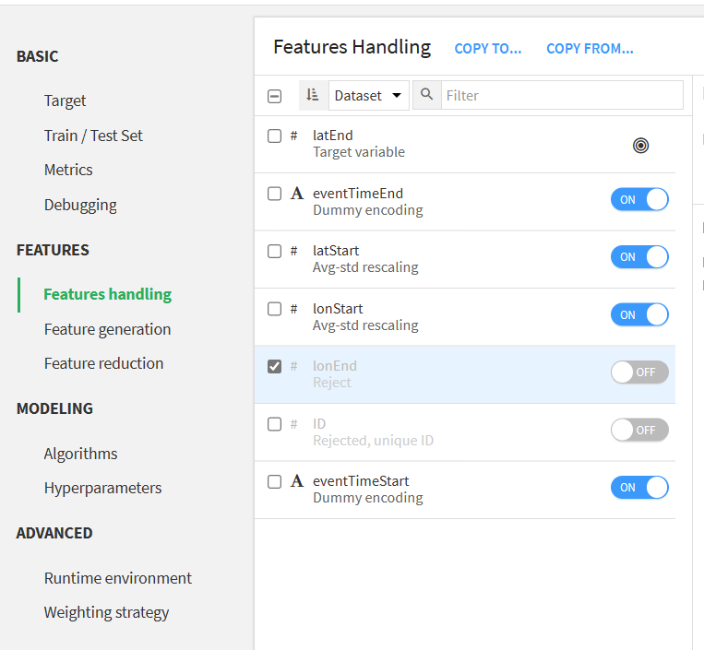
In Features and handling we will tick eventStartTime and Untick the lonEnd(Longitude End) because we have to first find the latitude End Dataset and from the resulting dataset we will score the final Longitude End.

Slide 16
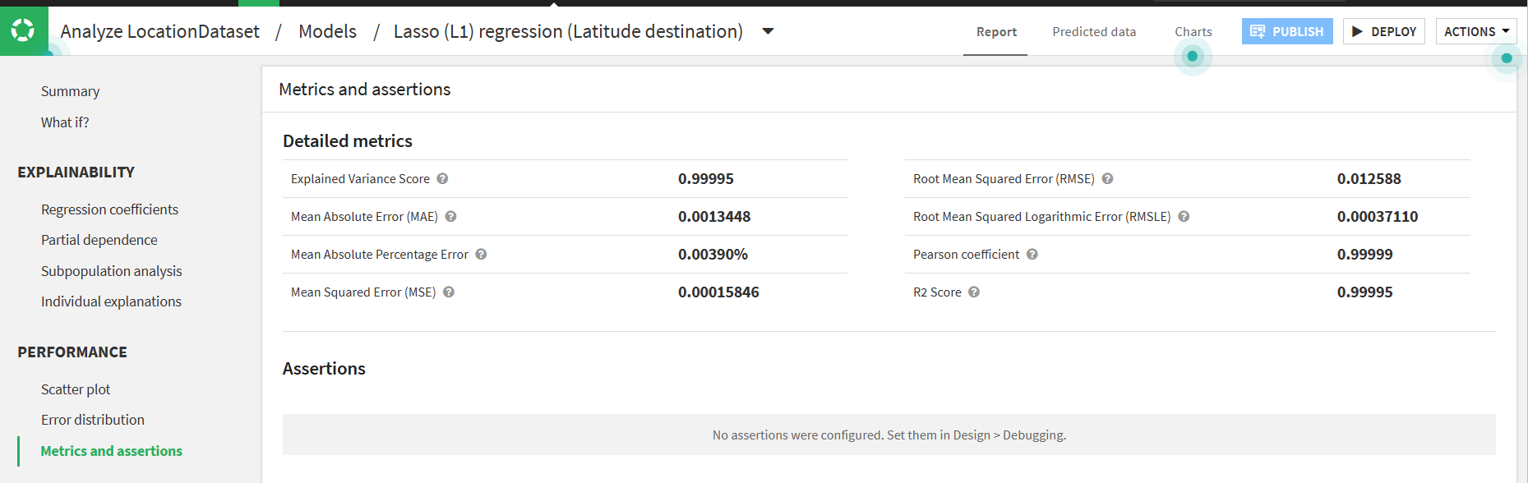
By click the train the tool will start the implementation of lasso regression algorithm on the dataset. After the implementation it will provide the R2 Score and mean error in the matrics and assertion section

Slide 17
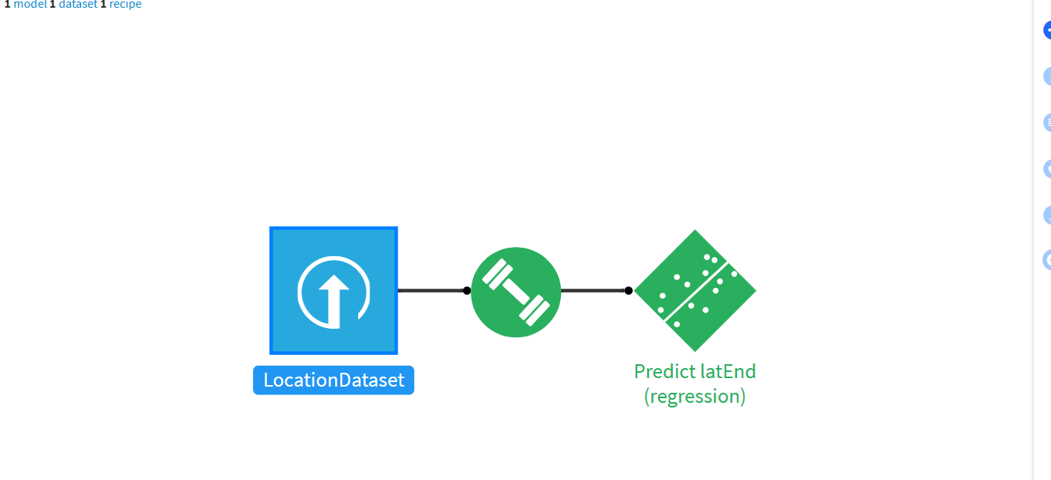
After training we have to deploy our model. We will click deploy in the Right Corner.
After deployment the flow will look like this

Slide 18
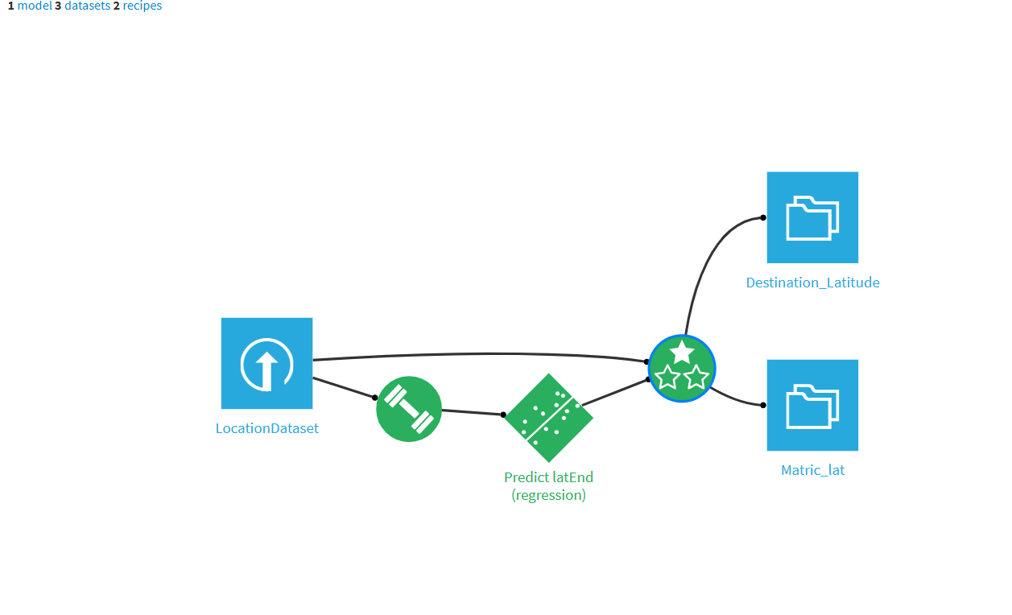
Now we will Evaluate the model By clicking Predict latEnd(regression) in the flow →Evaluate in the panel
We will Select input dataset as location dataset and we will a general name to the output dataset. In this we have also set an matrics dataset.
The flow will get updated.

Slide 19
Now from the output Destination Latitude we can find the Destination Longitude.
To do so we will create a model using the XGBoost regression Algorithm. We are Selecting it because this algorithm also gives the highest accuracy.

Slide 20
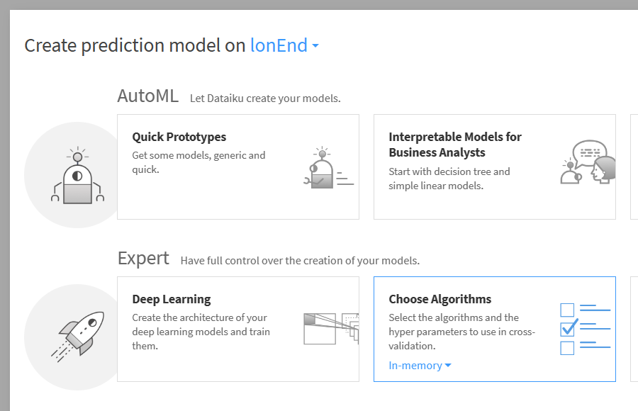
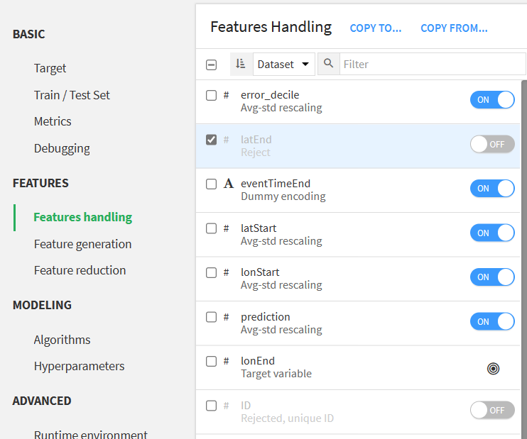
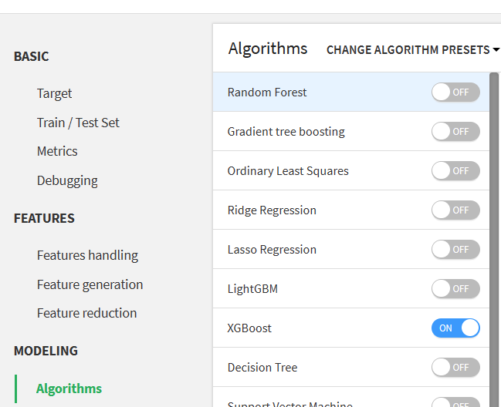
In the dataset we will now target to lonEnd(Longitude End) as we to find the destination Longitude
In Features and handling we will untick the latEnd column

Slide 21
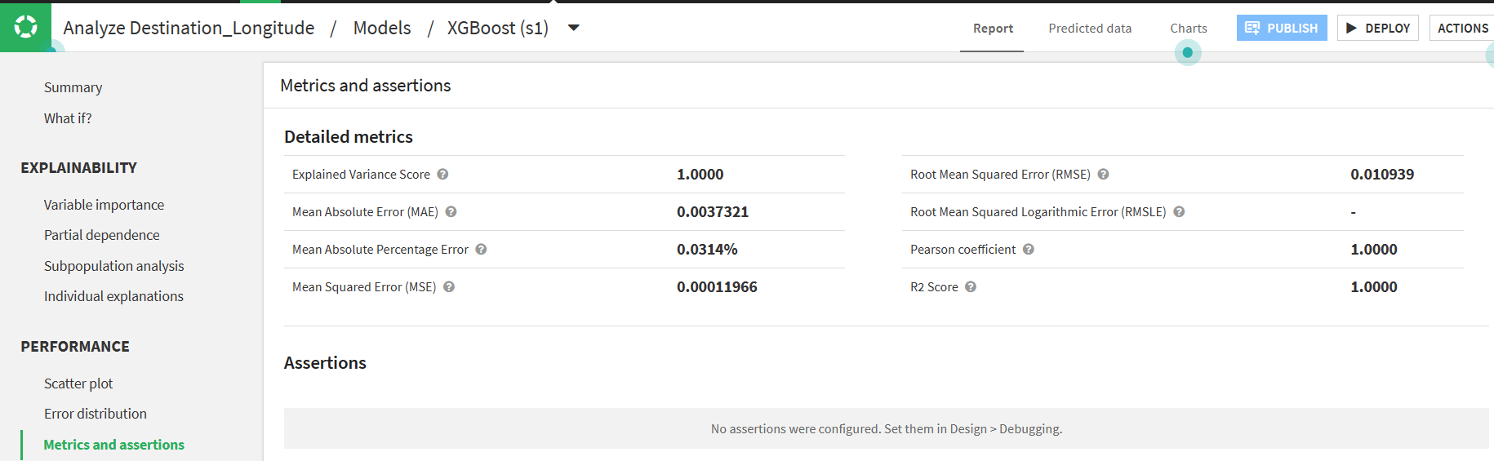
We will Train the model and see for the R2 Score and mean errors
in the matrics and assertion section.

Slide 22
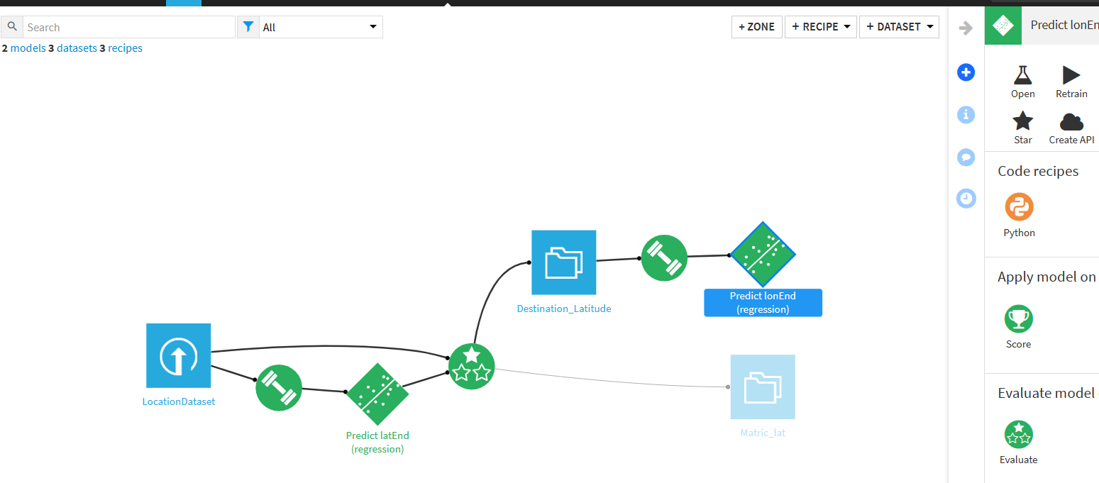
As we can Observe the R2 Score has 100% value and errors have less values. So this algorithm is perfect to deploy. So we Deploy it and the Flow will be get updated.

Slide 23
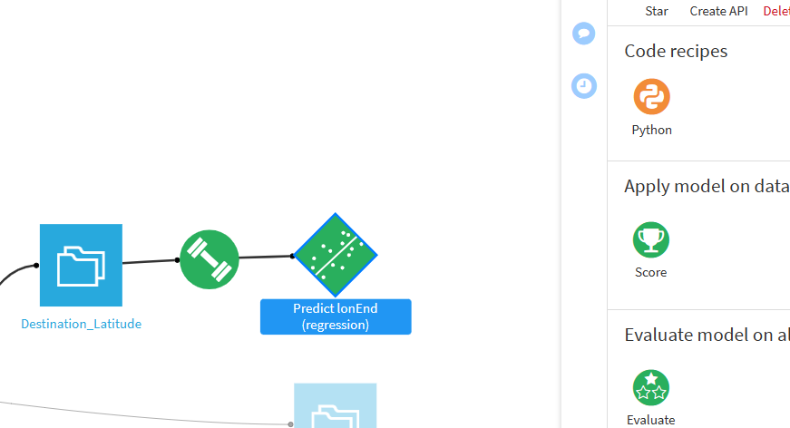
Using this model we will score for the Destination Longitude dataset. By clicking score in the panel.

Slide 24
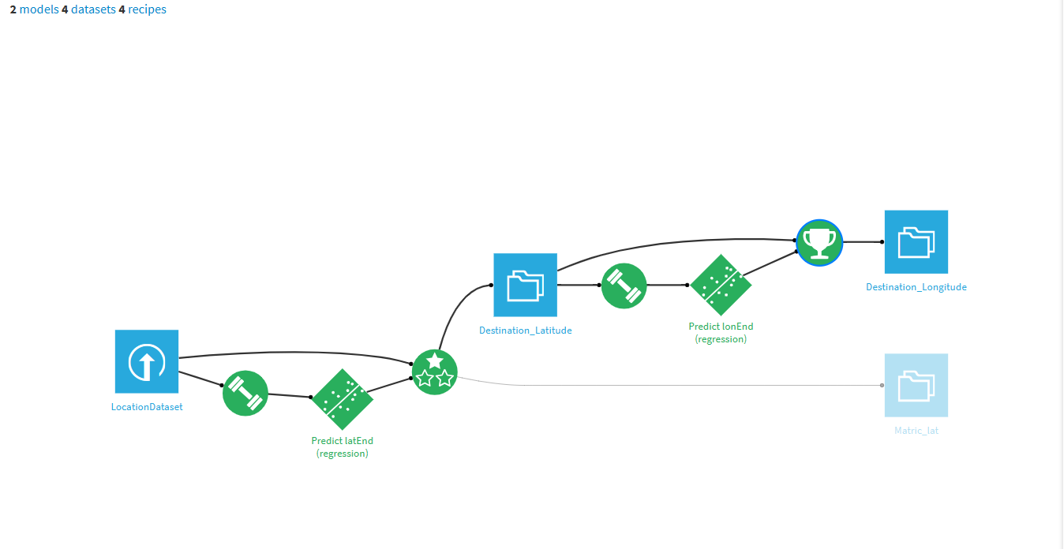
After Scoring the model will provide the final Destination Longitude Dataset. And the flow will be update like the following

Slide 25
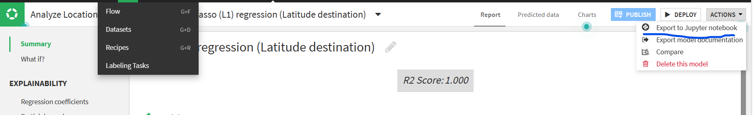
In Dataiku tool we can also explore the implemented models python code in jupyter. Just Export to Jupyter Notebook

Slide 26
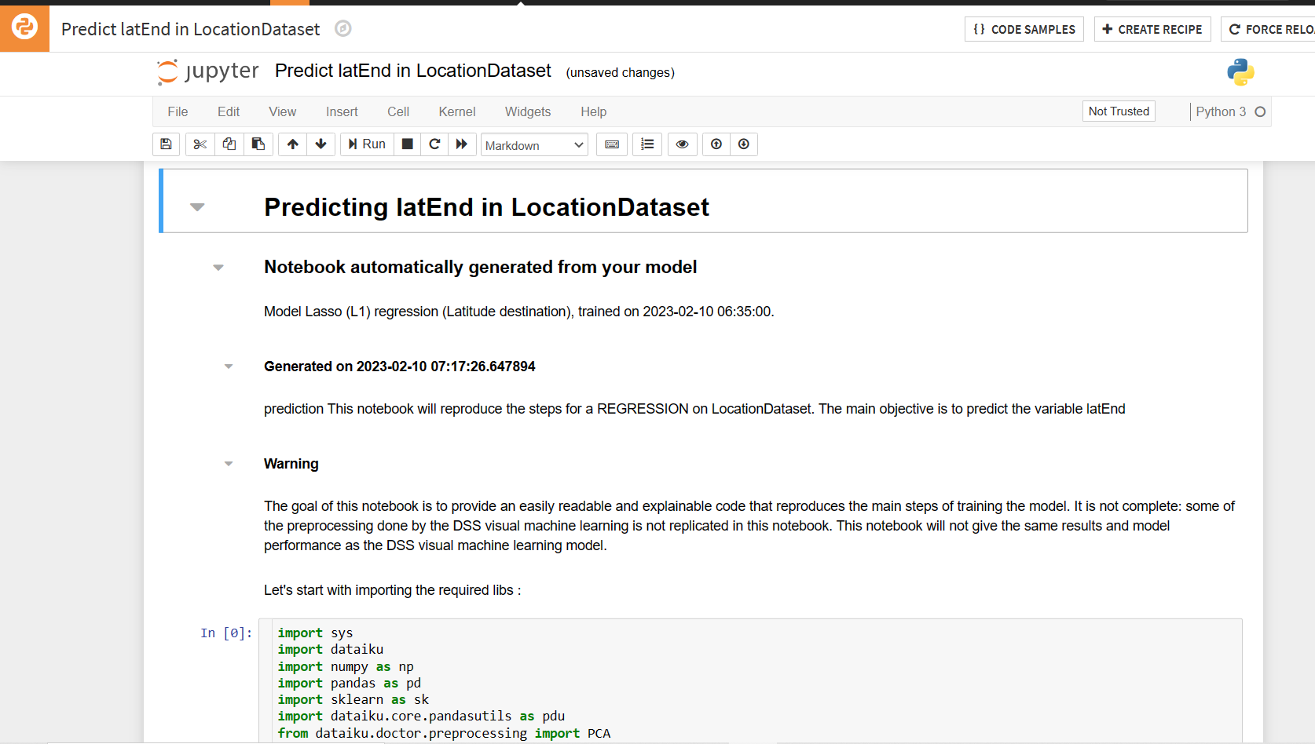
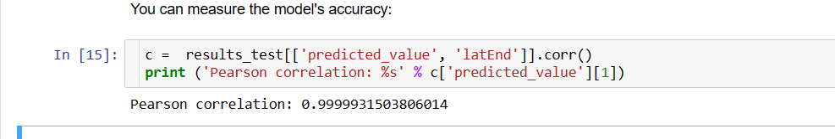
By Exporting it will generate a python code automatically. In Jupyter Notebook.
We can also look for the accuracy percentage by running that python code

Slide 27
Conclusion:-
So using the dataiku tool we can build different types of models using different types of algorithms, we can do operation on different datasets and from them we can generate new datasets.
Also we can explore the implemented model’s python code in jupyter notebook.

Slide 28
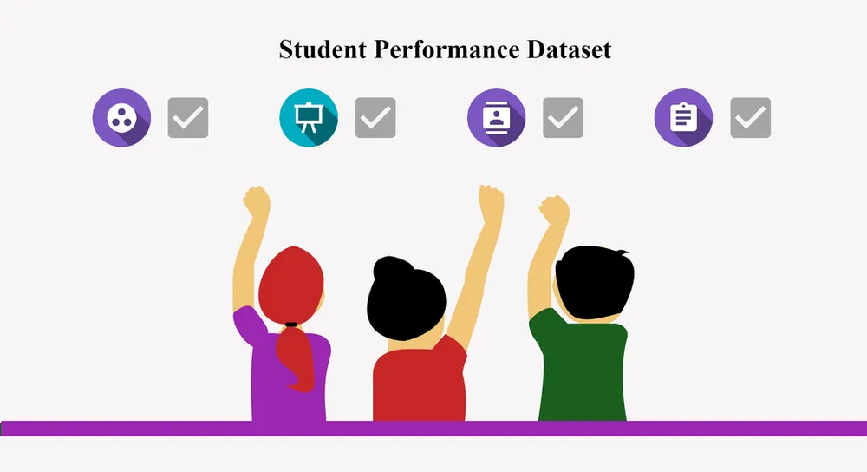
Predictive Modeling on Student Performance
Project-2

Slide 29
Task Description :
Download the "Student Performance" dataset from Kaggle: https://www.kaggle.com/spscientist/students-performance-in-exams
2.Build a predictive model to predict the math score of a student based on other variables such as gender, race/ethnicity, parental level of education, lunch, and test preparation course.
3.Use supervised learning algorithms such as decision trees, logistic regression, and random forests to build the model.
4.Evaluate the model using appropriate metrics such as accuracy, precision, recall, and F1 score.
5.Use feature selection techniques to identify the most important features for predicting the math score.

Slide 30
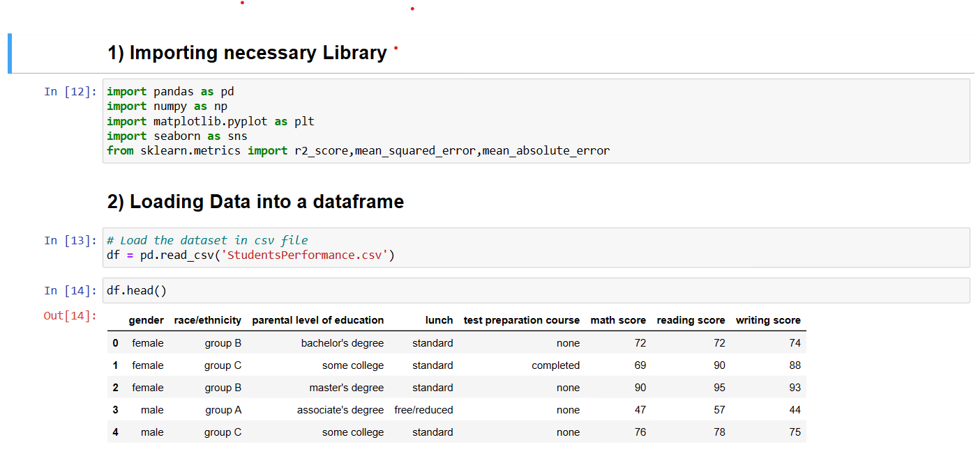
ImPORTING AND Loading dataset

Slide 31
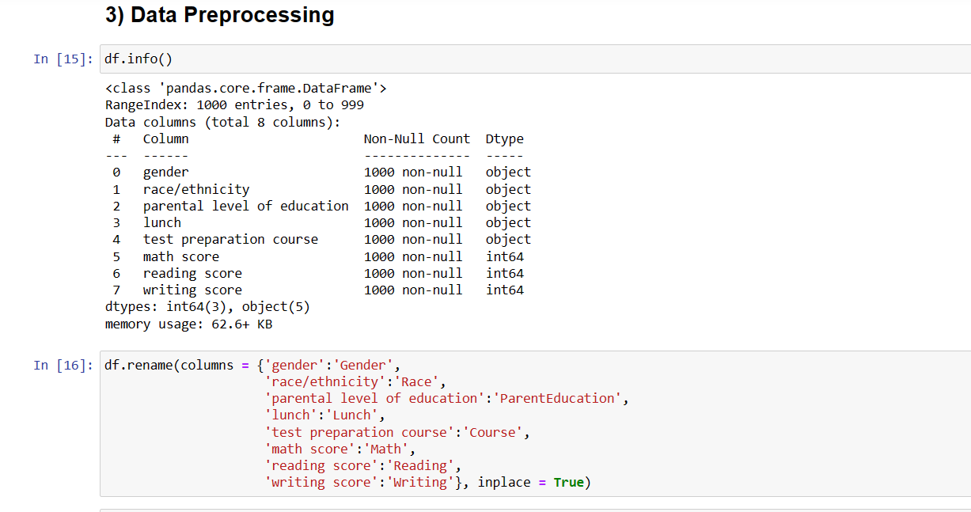
Data Preprocessing
Data preprocessing is a crucial step in machine learning that involves transforming raw data into a suitable format that can be used for training machine learning models. The main goal of data preprocessing is to clean and prepare the data so that it can be easily and accurately analyzed by machine learning algorithms.

Slide 32
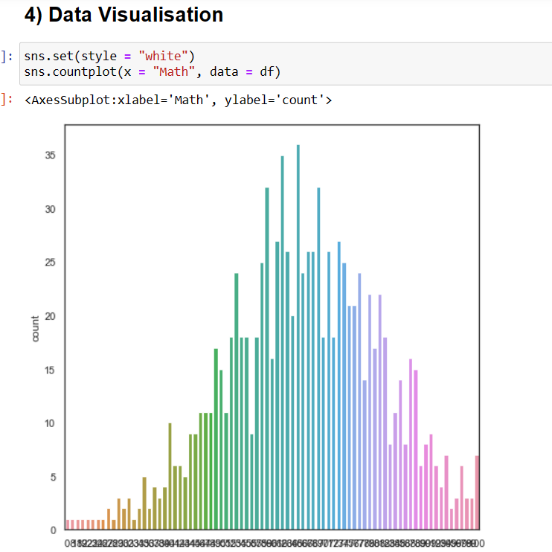
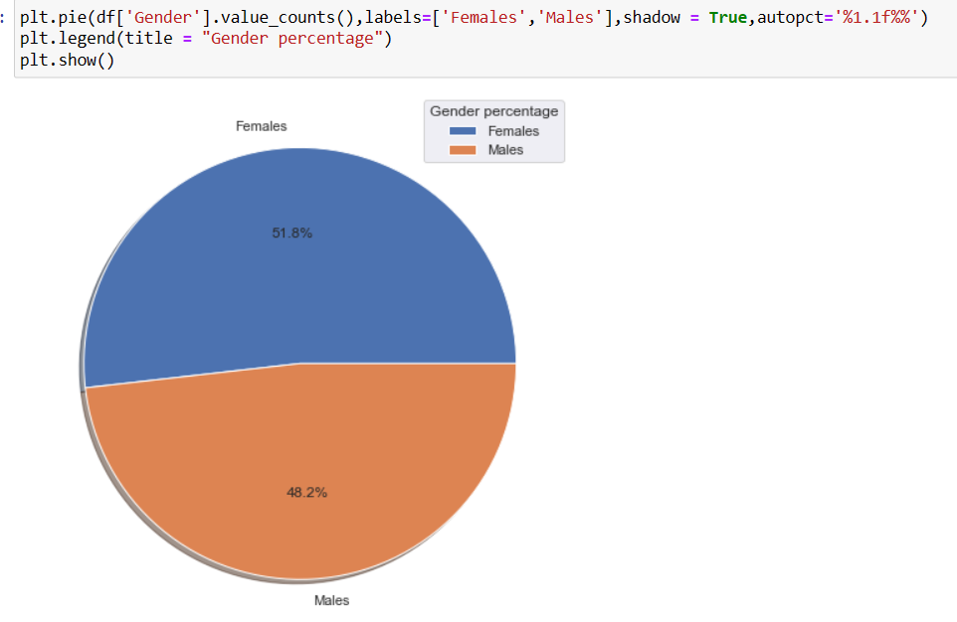
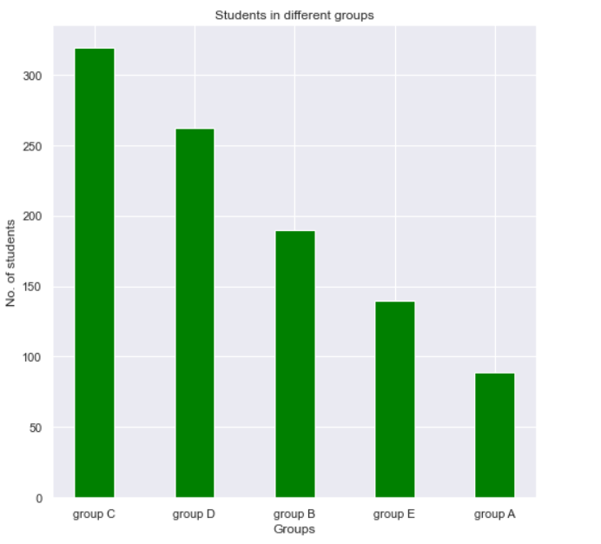
Data Visualisation
Data visualization is an essential step in machine learning that involves representing data in a graphical or visual format. The main goal of data visualization is to gain insights and understanding from the data that are not easily obtainable from raw data alone.

Slide 33
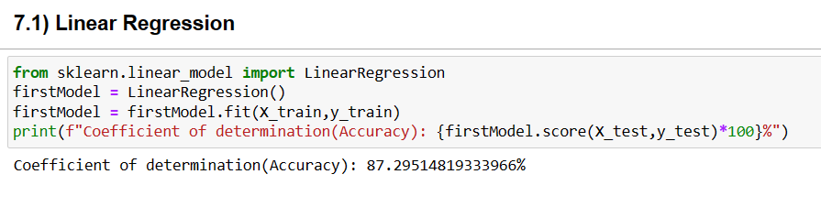
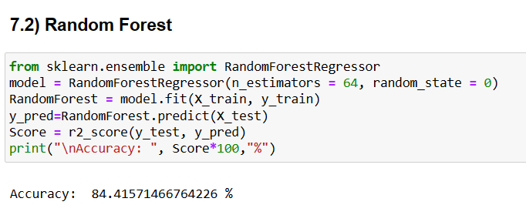
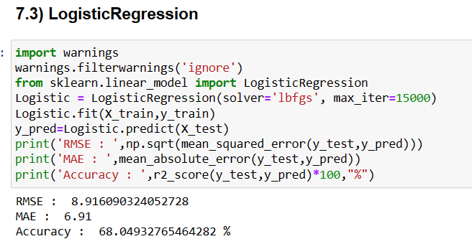
Applying machine learning algorithms

